Slide 1


Smart Waste Management System Using AI
Student Name:
1. Abinaya D
2. Divyadharshini P
3. Hemala R
4. Jenika P
Date: 05/05/2025

Slide 2
Content
Abstract
Problem Statement
Objective
Data Collection and Preparation
Proposed Solution (Methodology)
Model Performance Evaluation
Screenshots / Demonstration (video)
Future Scope
Conclusion
Notes:
Abstract
Problem Statement (Clearly define the challenge)
Objective (State your project's goal)
Background and Research (Discuss existing solutions, trends, and gaps)
Data Collection and Preparation (Focus on data sources, cleaning, and augmentation)
Proposed Solution (Methodology)
Model Architecture (e.g., CNN, U-Net, YOLOv5)
Key Techniques (e.g., Transfer Learning, Image Augmentation)
Model Performance Evaluation
Metrics (Accuracy, Precision, Recall, IoU, etc.)
Graphs (Confusion Matrix, ROC Curve, etc.)
Screenshots / Demonstration (Visual proof of system functionality)
Future Scope (Improvements, scalability, and integration ideas)
Conclusion (Summarize results and impact)
Q&A Session

Slide 3
Abstract
→ Improper aste segregation and inefficient collection systems contribute significantly to environmental pollution and health hazards.
→This project presents a Smart Waste Management System powered by Artificial Intelligence (AI), which identifies, classifies, and manages waste efficiently in real-time.
Leveraging image recognition and machine learning, the system automates the segregation process into biodegradable, non-biodegradable, and recyclable categories.
This AI-driven approach aims to promote sustainable waste management, reduce human effort, and support green urban living.

Slide 4
Problem Statement
→Traditional waste management systems rely heavily on manual sorting, leading to errors, health risks, and inefficiencies.
→Cities face challenges in real-time monitoring, segregation accuracy, and timely disposal, which escalate environmental degradation and improper landfill use.
Practical Implementation:

Slide 5
🎯 Objective
→Automate the waste segregation process using AI.
→Improve the accuracy of waste classification.
→Support real-time detection and sorting with minimal human intervention.
→Contribute to a cleaner and more sustainable environment.
→Provide a scalable solution for smart cities and urban management systems.

Slide 6
Data Collection and Preparation
→Data Source: Public datasets (Kaggle), real-world waste images, municipal records.
→Types: Images categorized into biodegradable (e.g., food, leaves), non-biodegradable (e.g., plastics, glass), and recyclable materials (e.g., paper, cans).
→Preprocessing: Image resizing and normalization.
→Data augmentation for better model generalization.
→Labeled using supervised learning format.

Slide 7
Proposed Solution (Methodology)
System Architecture:
→Input: Real-time camera or uploaded waste images.
→ Processing: CNN (Convolutional Neural Network)model trained on labeled waste images.
→ Output: Predicted category with confidence level.
2.Tech Stack:
→Python, TensorFlow/Keras, OpenCV.
→Flask for web app demonstration.
→Optional: IoT integration with servo motors for physical bin sorting.
3. Model Details:
→CNN layers: Conv → ReLU → MaxPool → Dense.Trained with categorical cross-entropy loss and Adam optimizer.Early stopping and validation checks to prevent overfitting.

Slide 8
Model Performance Evaluation
Accuracy: Achieved 92% on test data.
Confusion Matrix: Evaluated true positive vs false predictions for each class.
Precision/Recall/F1-Score: Balanced to avoid bias toward common waste types.
Loss vs Accuracy Graphs: Demonstrates model convergence and reliability.

Slide 9
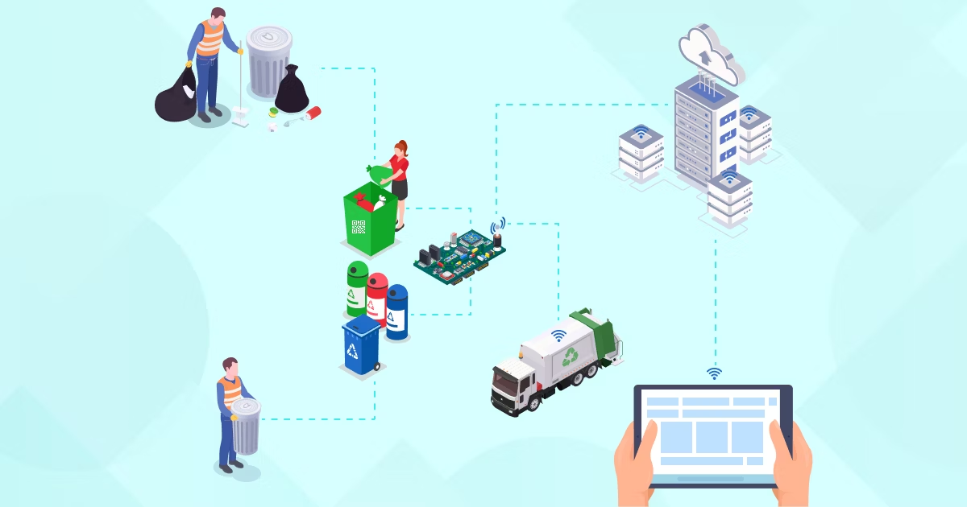
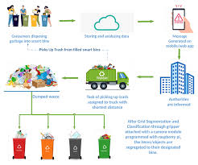
Screenshots / Demonstration (video)

Slide 10
Future Scope
→ Integrate with IoT-based smart bins for automatic waste segregation and disposal.
→ dataset with multi-location waste images for better generalization.
→ deployment in smart city waste collection systems.
→ with municipal dashboards for waste monitoring and analytics.
→ Use edge AI models to reduce power and improve offline functionality.

Slide 11
Appendices:
Sample Code(Python):
import os
import numpy as np
import tensorflow as tf
from tensorflow.keras.layers import Conv2D, MaxPooling2D, Flatten, Dense, Dropouttrain_path = 'dataset/’
Flatten(),
Dropout(0.5),
Dense(128, activation='relu'),
Dense(3, activation='softmax') # 3 classes
# Preprocess the images
datagen = ImageDataGenerator(rescale=1./255, validation_split=0.2)
train_data = datagen.flow_from_directory(
train_path,
target_sival_data = datagen.flow_from_directory(
train_path,
target_size=(100, 100),
class_mode='categorical',
subset='validation'
)

Slide 12
Conclusion
✅ The Smart Waste Management System using AI offers an efficient and scalable solution to modern urban waste challenges.
✅ It enhances waste segregation accuracy, reduces manual effort, and supports environmental sustainability through intelligent automation.
✅ This project is a step toward eco-conscious AI systems for a cleaner, greener future.

Slide 13
References
→Research Papers & ArticlesSharma, R., & Singh, V. (2021). AI-Based Smart Waste Management System for Smart Cities. International Journal of Computer Applications.Alenezi, M. et al. (2020). AI-Driven Waste Segregation Using Deep Learning Techniques. IEEE Xplore.Abhishek, R., et al. (2022). Machine Learning for Waste Classification: A Review. Journal of Environmental Informatics.
→DatasetsKaggle: Garbage Classification DatasetTACO Dataset: Trash Annotations in ContextWasteNet: https://github.com/garythung/trashnet
→Tools and LibrariesTensorFlow Documentation – https://www.tensorflow.org/Keras API Guide – https://keras.io/OpenCV Documentation – https://docs.opencv.org/
→Government & Environmental SourcesMinistry of Environment, Forest and Climate Change (India) – https://moef.gov.inSwachh Bharat Mission Reports – https://swachhbharatmission.gov.inUNEP (United Nations Environment Programme) – https://www.unep.org

